Slide 1

ADAPTIVE THINKING AT WORK
THE BOX IS NOT
THE COURT
How the evolution of basketball explains adaptive organisations
TOMASZ MAZURKIEWICZ · ADAPTIVE LABS
Notes:
Source: Adaptive Labs perspective, “The Box Is Not the Court”. Cover.

Slide 2

EVOLUTION OF THE BOX · 01
The court and the box
THE COURT
THE BOX
Stable ground
Current operating model
Purpose and accountability
Law and ethics
Non-negotiable operating principles
Role definitions
Preferred tactics
Accepted sources of authority
Assumptions about good decisions
A player reveals more space. The system responds. Success creates a new box. An adaptive system questions it again.
The goal is not to keep thinking outside the box. It is to build a system that no longer needs the box to hold together.
ADAPTIVE LABS 02
Notes:
Source: Adaptive Labs perspective, “The Box Is Not the Court”. Section 01: The court and the box. Bottom line is the article’s lead quote.

Slide 3

EVOLUTION OF THE BOX · 02
Seeing more space without changing the game
A role can carry more intelligence than the operating model assigns to it.
GEORGE MIKAN · THE SYSTEM ADJUSTS
BOB COUSY · THE ROLE EXPANDS
Dominance exposed the limits of the rules
Creation became a competitive advantage
His size and hook shot made the early game brutally direct. The lane was widened and goaltending rules developed.
He treated the whole court as a field of possibility. He did not need a new court. He used more of the court already there.
Player reveals the limit → the league changes the rules
The rules stay → the role carries more
Not everyone had equal access to this space. A system can celebrate innovation while deciding selectively who is allowed to embody it.
ADAPTIVE LABS 03
Notes:
Source: Adaptive Labs perspective, “The Box Is Not the Court”. Section 02: Seeing more space without changing the game. Two distinct mechanisms: Mikan reveals the limits and the league adjusts the rules; Cousy expands the role on the existing court. The access line reflects the article’s point that creative freedom was not distributed equally in a segregated society.

Slide 4

EVOLUTION OF THE BOX · 03
Harlem Globetrotters
Innovation beside the dominant system
A parallel arena let constrained forms of expression develop, mature and become visible.
A sandbox creates value only when learning can cross back into the operating model.
The crossing happened: Wilt Chamberlain spent the 1958–59 season with them before entering the NBA.
Julius Erving joined the NBA in 1976. The ABA’s three-point line followed in 1979–80.
Parallel space matters only when its learning changes the core.
ADAPTIVE LABS 04
Notes:
Source: Adaptive Labs perspective, “The Box Is Not the Court”. Section 03: Innovation beside the dominant system. The Chamberlain line bridges to the next slide. ABA (1967–76) as a second parallel arena. Julius Erving entered the NBA in 1976 through the merger; the NBA introduced the ABA three-point line in 1979–80. Sources: NBA.com, “Legends profile: Julius Erving,” https://www.nba.com/news/history-nba-legend-julius-erving; NBA.com, “Doubt, disdain marked most NBA teams’ first forays into 3-point land,” https://www.nba.com/news/history-3-pointer-evolution-nba-game-larry-bird-stephen-curry-james-harden.

Slide 5
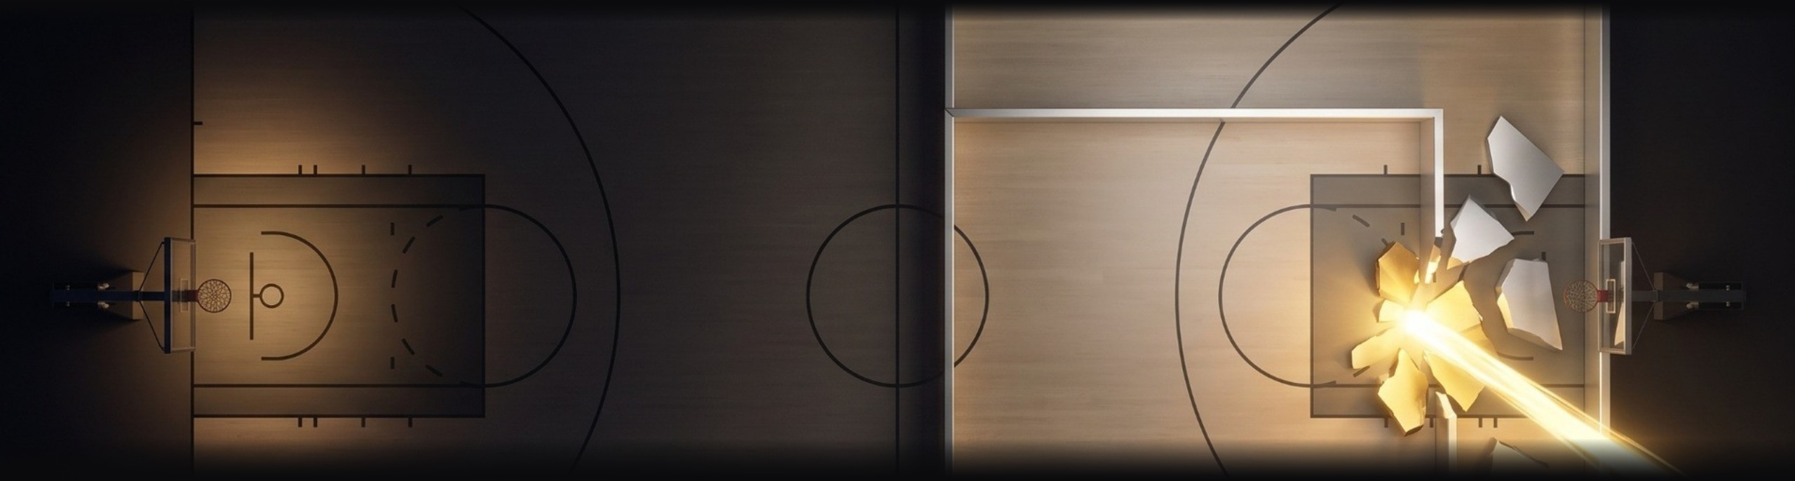
EVOLUTION OF THE BOX · 04
WILT CHAMBERLAIN
His scale made the prevailing model unstable.
His dominance made the assumptions obsolete. The rules changed. The court did not.
ADAPTIVE LABS 05
Notes:
Source: Adaptive Labs perspective, “The Box Is Not the Court”. Section 04: When one player makes the model obsolete.

Slide 6
EVOLUTION OF THE BOX · 04
Pressure builds until the constraints move
01
02
03
04
Teams change
personnel
Defences collapse toward
Wilt Chamberlain
Local responses no longer
restore balance
The league changes
constraints
Local fixes to a new reality
The system concentrates around one player
More effort, the same imbalance
A wider lane and offensive goaltending restrictions
Optimisation inside the old model could no longer restore balance.
The changes came in the era shaped by his dominance. The rules moved. The court stayed the same.
ADAPTIVE LABS 06
Notes:
Source: Adaptive Labs perspective, “The Box Is Not the Court”. Section 04: system shock. Shows rising pressure and a change of constraints, without claiming that this example alone produced an entirely new operating model.

Slide 7

EVOLUTION OF THE BOX · 04
Two players, one new game
Russell changed what defence could do. Wilt changed what one player could do.
01
Russell (1956): rim protection and outlet passing turned defence into attack.
02
Wilt (1959): a scale the rules could not absorb.
03
Through the 1960s, their rivalry defined the game.
Together they broke the old box. Their rivalry cemented the new one.
The game now ran through the centre.
ADAPTIVE LABS 07
Notes:
Source: NBA.com, “Legends profile: Bill Russell,” https://www.nba.com/news/history-nba-legend-bill-russell. Russell’s defence protected the rim; defensive rebounds and outlet passes launched the Celtics’ fast break. Blocked shots were not officially recorded as a statistic until 1973–74. Visual: Gemini-generated image supplied by the user. Talking point: in 1966 Russell became the NBA’s first Black head coach, which links back to the access point on slide 3. Framing: Russell (NBA 1956) changed the logic of defence. Wilt (NBA 1959) brought a scale the rules could not absorb. Together they broke the old box and created a new game; their rivalry defined the 1960s and cemented it. Russell’s Celtics won 11 titles in 13 seasons and beat Wilt’s teams in 7 of 8 playoff series. West and Baylor shaped the era too, but worked inside this model.

Slide 8

EVOLUTION OF THE BOX · 05
The Adaptive Trap
Once the league learned to organise around dominant centres, the breakthrough hardened into another box. Business repeats the pattern:
01
A successful response solves a real problem.
02
Success turns the response into doctrine.
03
Structures, measures and careers accumulate around it.
A breakthrough is not the end of the box. It is often the beginning of the next one.
“You can’t teach height” favoured tall players for decades. The breakthrough became doctrine.
ADAPTIVE LABS 08
Notes:
Source: Adaptive Labs perspective, “The Box Is Not the Court”. Section 05: Yesterday’s breakthrough becomes today’s constraint. “You can’t teach height” is a basketball maxim that favoured tall players for decades and became doctrine in the centre era. Magic Johnson and Larry Bird (next slide) are where the league starts to open again.

Slide 9
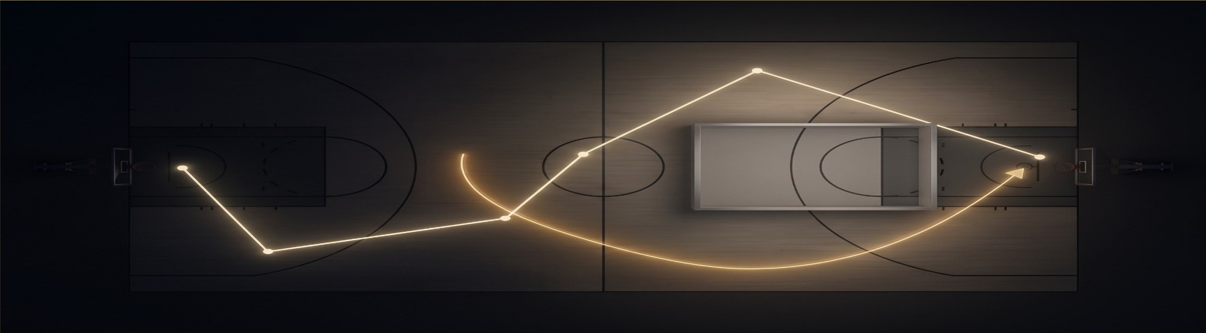
ADAPTIVE DNA · 06
Two forms of intelligence. One shared court.
MAGIC JOHNSON
LARRY BIRD
Vision across roles: size moved into the point guard position, weakening the narrow description of a role.
A different intelligence: anticipation and precision showed the game could hold contrasting ways of seeing.
ADAPTIVE LABS 09
Notes:
Source: Adaptive Labs perspective, “The Box Is Not the Court”. Section 06: The game opens again. Label aligned with stage 06 (Adaptive DNA) of the model.

Slide 10
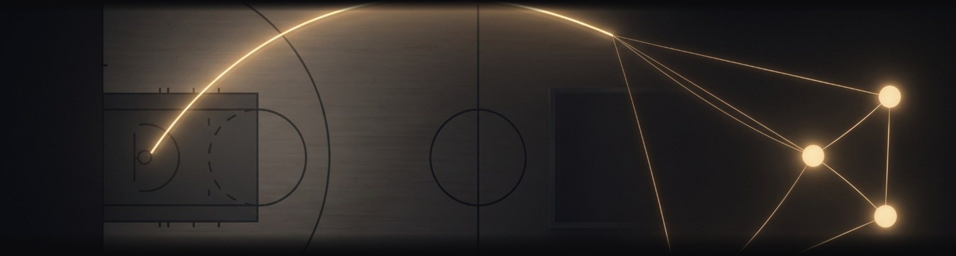
ADAPTIVE DNA · 06
MICHAEL JORDAN · DAVID STERN
The game no longer ended at the court.
Jordan helped redefine what the product was. Stern connected the parts around the game: rules, media, brands and global reach.
ADAPTIVE LABS 10
Notes:
Source: Adaptive Labs perspective, “The Box Is Not the Court”. Section 07: From a new game to a learning system.

Slide 11

ADAPTIVE DNA · 06
From connected ecosystem to adaptive enterprise
1
Jordan expanded what the product could become.
SYSTEM DESIGN
MEDIA
2
Air Jordan carried the game into design, media and culture.
CULTURE
3
Stern connected rules, media, brands and reach around it.
4
Stern is the closest figure here to a Business System Architect.
PERFORMANCE
THE GAME · SHARED PURPOSE, A STABLE COURT
Embedded Governance protects the integrity of the game without freezing the current operating model.
ADAPTIVE LABS 11
Notes:
Source: Adaptive Labs perspective, “The Box Is Not the Court”. Section 07: Stern as the closest figure to a Business System Architect (article wording).

Slide 12

ADAPTIVE DNA · 06
The system learns to absorb new archetypes
KOBE BRYANT
LEBRON JAMES
STEPHEN CURRY
VICTOR WEMBANYAMA
Relentless refinement
Orchestration across roles
Geometry rewritten by range
Categories stop describing the player
The court remains recognisable. The definition of a player keeps evolving. Not chronology — capacity.
ADAPTIVE LABS 12
Notes:
Source: Adaptive Labs perspective, “The Box Is Not the Court”. Section 07: The system can absorb new archetypes without requiring them to leave and create a separate game.

Slide 13
THE MODEL BEHIND THE ARTICLE
The evolution of the box
01
02
03
04
05
06
The box
Expanding the box
Signals beyond it
Breaking the box
Adaptive Trap
Adaptive DNA
→
→
→
→
✦
The established operating model defines what appears possible.
New thinking stretches roles and rules without changing the underlying logic.
Outliers, experiments and external ideas reveal what the core cannot yet absorb.
Reality makes the existing model obsolete. The system must redesign itself.
Success becomes doctrine and slowly becomes the next constraint.
The system learns to question, redesign and renew its own operating logic.
Adaptive Thinking does not replace one box with another. It builds the capability to recognise when today’s answer has begun to become tomorrow’s constraint.
COURT: PURPOSE AND BOUNDARIES SPIRAL: OBSERVE, CONNECT, ACT, LEARN, REVISIT GOVERNANCE: PROTECT THE GAME
Basketball history is used as an interpretive lens. It does not claim that the NBA or its participants consciously applied Adaptive Thinking.
ADAPTIVE LABS 13
Notes:
Source: Adaptive Labs perspective, “The Box Is Not the Court”. Section 08: Breaking the box is not enough. Stage names and descriptions follow the article.

Slide 14

PROTECT THE GAME, NOT THE BOX.
Keep the court. Question the box. Redesign the rules that prevent the system from learning.
ADAPTIVE LABS · ADAPTIVELABS.EU
Notes:
Source: Adaptive Labs perspective, “The Box Is Not the Court”. Closing. Embedded Governance: protect the game, not the box.

