Slide 1
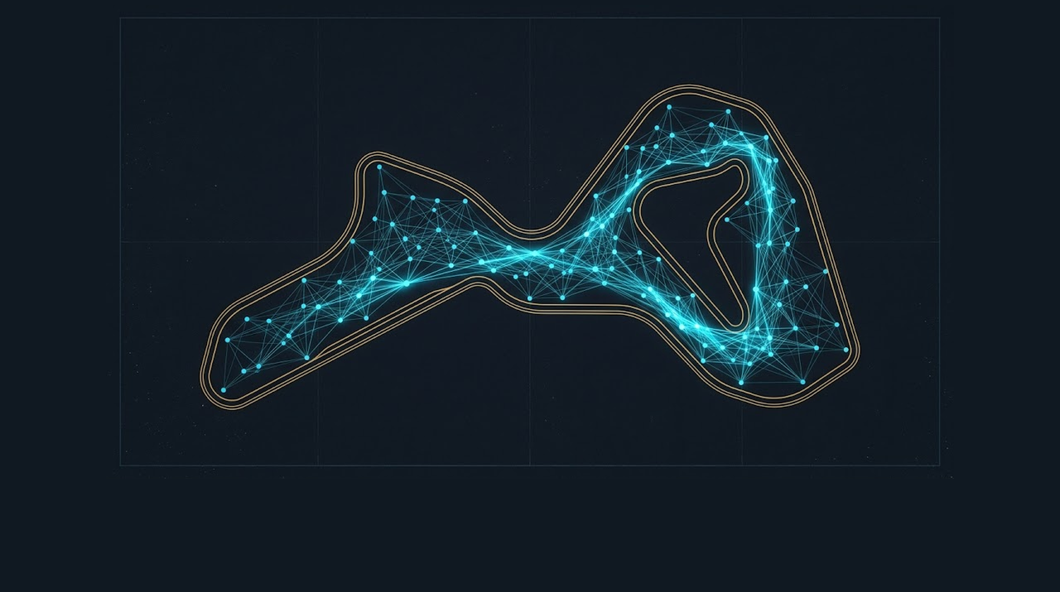
No One Wins Le Mans from the Org Chart
Ken Miles, Carroll Shelby and the Business System Architect function
TOMASZ MAZURKIEWICZ / ADAPTIVE LABS
Notes:
Source: Adaptive Labs perspective, “No One Wins Le Mans from the Org Chart”.
The perspective uses the organisational dynamics portrayed in Ford v Ferrari as a lens. The film compresses events and dramatises individuals, particularly Leo Beebe; the argument concerns the organisational mechanism, not a historical judgement on any individual.

Slide 2
ADAPTIVE LABS / STORY PERSPECTIVE
A parts list does not make a system
Ford had capital, engineering, manufacturing scale and a clear aim: defeat Ferrari. Its early GT40 entries still failed to finish.
A LEARNING SYSTEM HAD TO CONNECT
The missing capability sat between the functions.
Track
Engineering
Mechanics
Race decisions
driver feedback
design response
operational test
action under pressure
A winning car emerged from connected learning, not any single box on the chart.
ADAPTIVE LABS / ADAPTIVE THINKING AT WORK
02 / 10
Notes:
Source: Adaptive Labs perspective, “No One Wins Le Mans from the Org Chart”.

Slide 3

ADAPTIVE LABS / STORY PERSPECTIVE
Miles knew the car at its limits
KNOWLEDGE FROM THE EDGE
A REPORT CAN RECORD
Ken Miles felt how the car behaved where assumptions met the track. His knowledge came from the boundary between driver, machine and speed.
Temperature
Vibration
Speed
Braking
Reality often challenges the model before it appears in a report.
A DRIVER CAN RECOGNISE
How those forces interact near the car’s limit.
ADAPTIVE LABS / ADAPTIVE THINKING AT WORK
03 / 10
Notes:
Source: Adaptive Labs perspective, “No One Wins Le Mans from the Org Chart”.

Slide 4
ADAPTIVE LABS / STORY PERSPECTIVE
Expertise needs a mandate to change the system
Miles could reveal the truth of the car. That did not mean he could make the organisation act on it.
Expertise makes a signal visible. Mandate gives people the right and the room to respond.
SIGNAL
UNDERSTANDING
MANDATE
DECISION
ADAPTIVE LABS / ADAPTIVE THINKING AT WORK
04 / 10
Notes:
Source: Adaptive Labs perspective, “No One Wins Le Mans from the Org Chart”.

Slide 5
ADAPTIVE LABS / STORY PERSPECTIVE
Each role saw a different part of the race
MILES
ENGINEERS
MECHANICS
SHELBY
FORD LEADERSHIP
MANAGEMENT
Performance and the physical truth of the car
Design limits, reliability and technical choices
Preparation, serviceability and execution
Relationships between specialists and the outcome
Capital, reputation, accountability and strategic value
Control, predictability and the risk of indispensable talent
Each perspective protected something real. The problem begins when one of them is allowed to define the whole reality.
ADAPTIVE LABS / ADAPTIVE THINKING AT WORK
05 / 10
Notes:
Source: Adaptive Labs perspective, “No One Wins Le Mans from the Org Chart”.

Slide 6
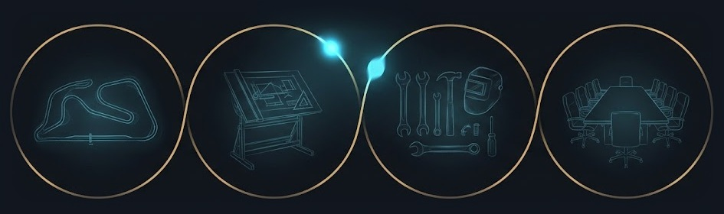
ADAPTIVE LABS / STORY PERSPECTIVE
Shelby kept the learning system connected
Shelby translated what each specialist knew into choices the team could test. He connected feedback from the track to engineering, workshop practice and executive support.
TRACK
DESIGN
WORKSHOP
DECISION
signal
translation
test
response
His contribution was coherence under pressure.
The function does not need to hold all expertise. It must help what each expert knows become part of one system.
ADAPTIVE LABS / ADAPTIVE THINKING AT WORK
06 / 10
Notes:
Source: Adaptive Labs perspective, “No One Wins Le Mans from the Org Chart”.

Slide 7
ADAPTIVE LABS / STORY PERSPECTIVE
The function comes before the title
A Business System Architect function appears when someone helps an organisation connect perspectives that its formal structure keeps apart.
No individual contains the whole capability. Together, they perform the function.
Expose dependencies
Translate insight into decisions
Learn from consequences
A new title cannot create the conditions the work requires.
ADAPTIVE LABS / ADAPTIVE THINKING AT WORK
07 / 10
Notes:
Source: Adaptive Labs perspective, “No One Wins Le Mans from the Org Chart”.

Slide 8

ADAPTIVE LABS / STORY PERSPECTIVE
Mandate gives the function room to work
FORMAL
Who has authorised the work
PRACTICAL
Whether people share time, information and expertise
COGNITIVE
Whether the accepted interpretation of reality can be questioned
POLITICAL
Whether the function is protected when authority feels challenged
EXECUTION
Whether insight can be tested through real decisions
Understanding without mandate becomes theatre. Mandate without understanding becomes control.
ADAPTIVE LABS / ADAPTIVE THINKING AT WORK
08 / 10
Notes:
Source: Adaptive Labs perspective, “No One Wins Le Mans from the Org Chart”.

Slide 9

ADAPTIVE LABS / STORY PERSPECTIVE
When the system fights back
A system may celebrate the result while resisting the person, behaviour and decision logic that made it possible.
At Le Mans 1966, a staged formation finish reframed victory through corporate image and control. No villains are needed — only locally rational actors protecting different forms of value.
ADOPT THE LANGUAGE
LIMIT THE MANDATE
CLAIM THE RESULT
MANAGE THE SOURCE
ADAPTIVE LABS / ADAPTIVE THINKING AT WORK
09 / 10
Notes:
Source: Adaptive Labs perspective, “No One Wins Le Mans from the Org Chart”. Section 08: When the system fights back.
The perspective uses the organisational dynamics portrayed in Ford v Ferrari as a lens. The film compresses events and dramatises individuals, particularly Leo Beebe; the argument concerns the organisational mechanism, not a historical judgement on any individual.

Slide 10

ADAPTIVE LABS / STORY PERSPECTIVE
Coherence must become an organisational capability
Exceptional people can bridge boundaries for a time. The organisation learns only when those connections survive beyond the people who first made them.
Build interfaces for critical information.
Make decision rights and escalation clear.
Protect legitimate challenge.
Let learning change the operating model.
Can the system keep learning when exceptional people step away?
ADAPTIVE LABS / ADAPTIVE THINKING AT WORK
10 / 10
Notes:
Source: Adaptive Labs perspective, “No One Wins Le Mans from the Org Chart”.

